Slide 1




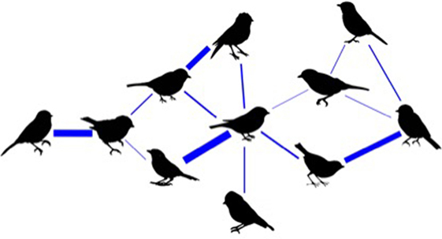
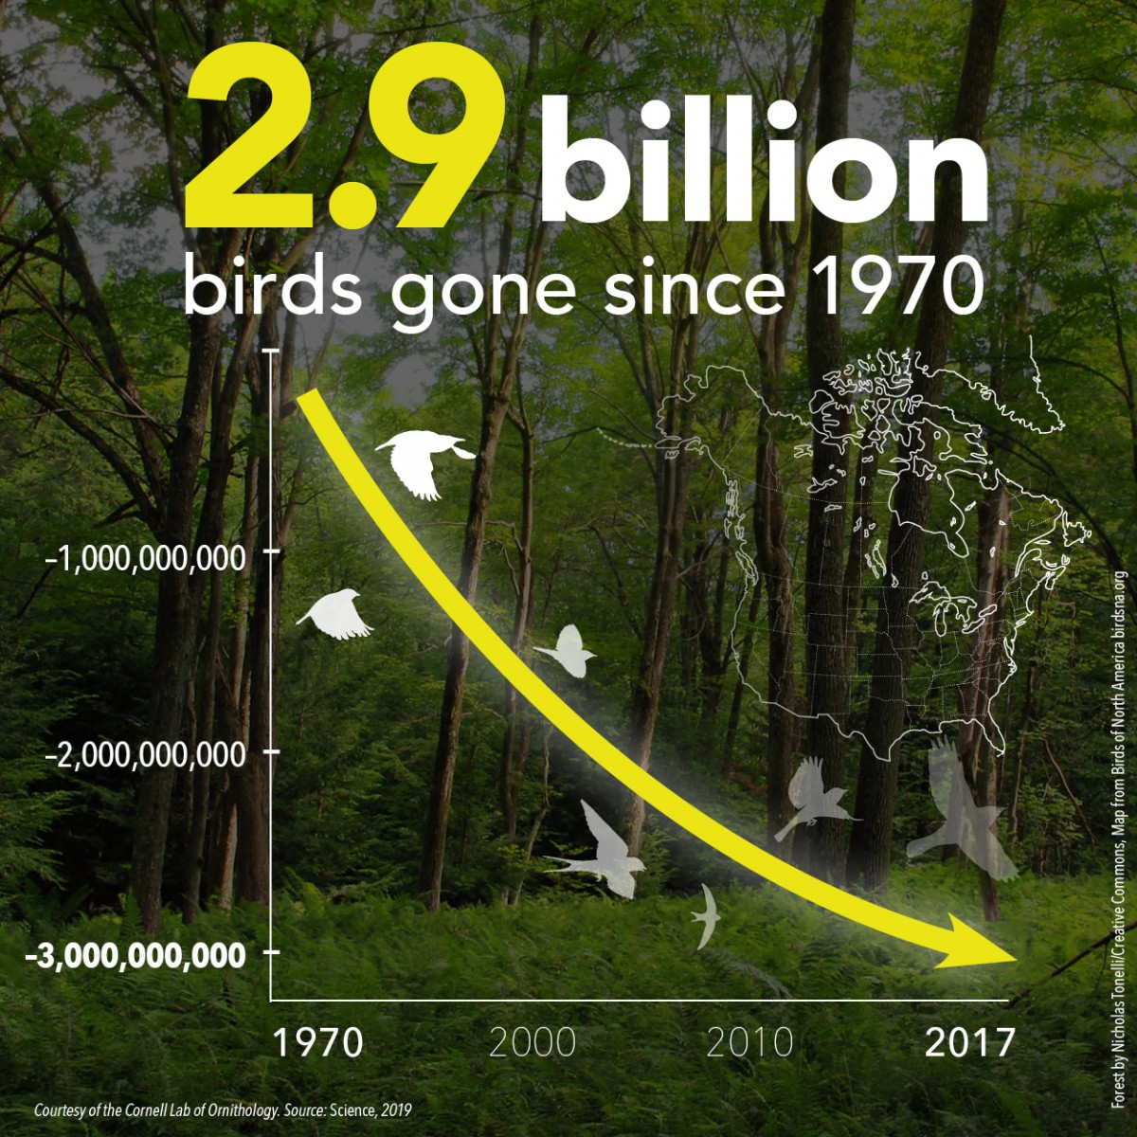
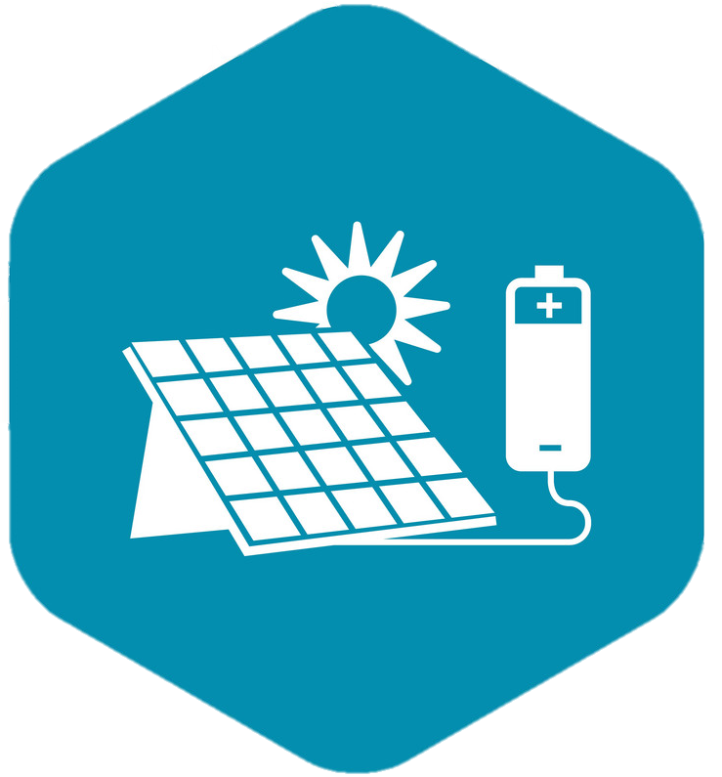

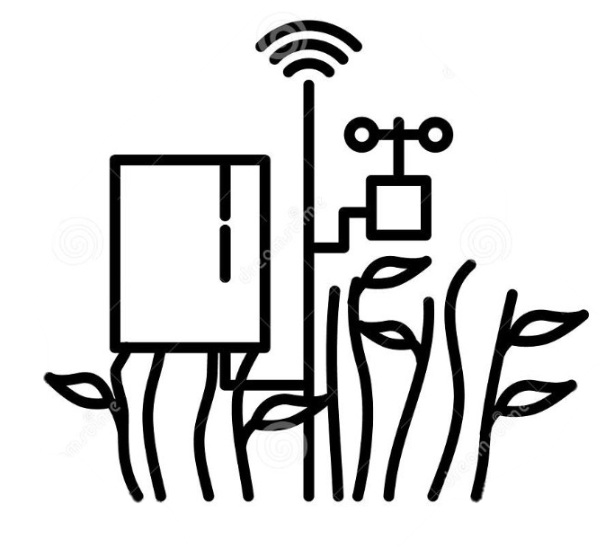

Envi-city
P. Das^{a*}, A. Sarkar^{b}, R.S. Kumarª.
ª Department of Electronics and Communication Engineering, SRM Institute of Science and Technology, Chennai,
Tamil Nadu 603203, India
^{b} Department of Electronics and Telecommunication Engineering, Jadavpur University, Kolkata,
West Bengal 700032, India * Email: pushpaldas2001@gmail.com
Social ,economic and environmental managed sustainable city
A city with sustainable energy, from the renewable sources mainly solar and vertical turbines ,with the primary objective for carbon elimination and six different automations. We are saving our eco system by removing networking vulnerabilities preserving the species of bird. Smart harvest of flood water , creating a a chain of automation with smart agriculture system delivering a healthy eco system thereby preventing water logging .
Smart networking
Sustainable energy
References
https://www.electricalindia.in/losses-in-distribution-transmission-lines/
https://www.rediff.com/news/interview/will-cell-phone-radiation-kill-off-birds-like-shown-in-20/20181220.htm
https://medcraveonline.com/IJAWB/the-electromagnetic-radiations-and-its-impacts-on-bird-diversity-in-india.html
Smart agriculture
First International Conference on Technologies for Smart Green Connected Society 2021
29th-30th November 2021 | Online | World Wide | 100+ Global Academic Partnerships & Alliances

